Slide 1
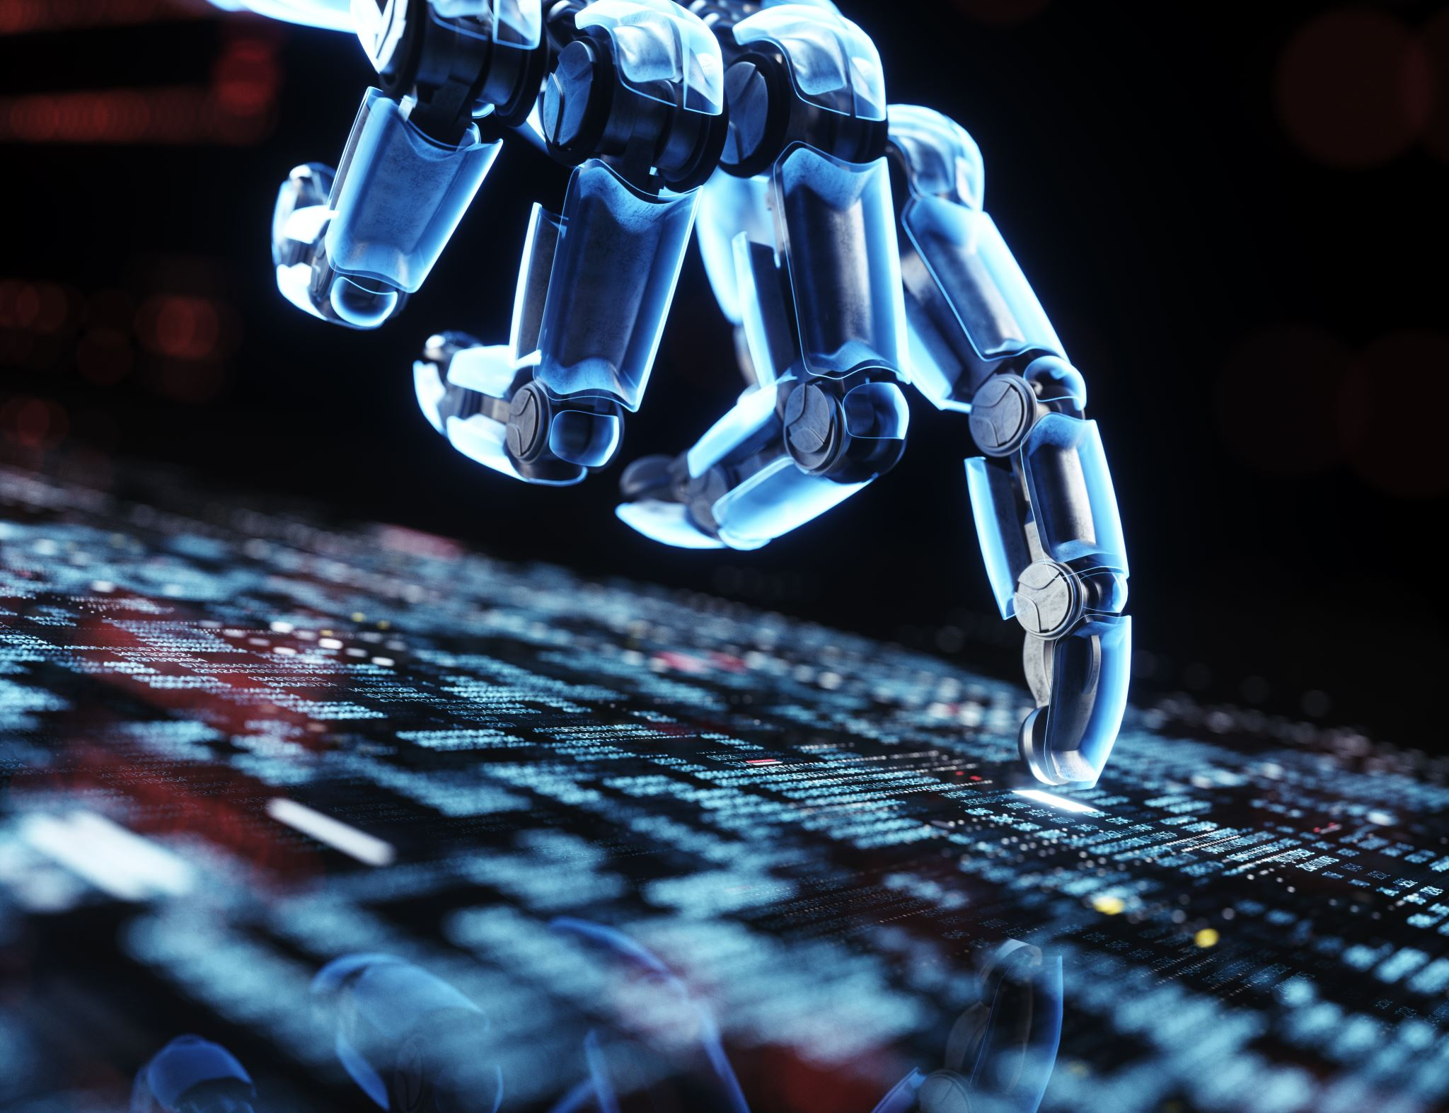

Humor Generation using AI
Dominic Munroe - C0832828
Mandil Karki -C0850688
Pranay Gurung - C0841092

Slide 2

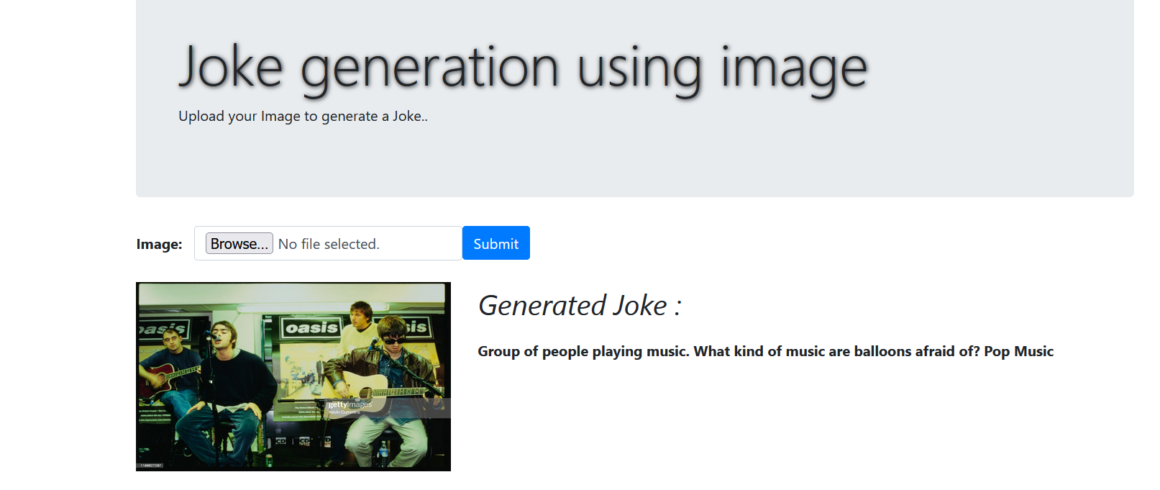

DASHBOARD/UI

Slide 3

Humor RESEARCH
Is Humor an identifiable human trait?
Humor is one of the most evolved characteristics we possess. The exact reasons why we laugh and what makes us laugh are still relatively unknown. The ability to understand and write jokes requires an understanding of different concepts. One must be aware of the world and the relationship between ideas and objects and be aware of linguistic structures that make a sentence funny, i.e., a strong understanding of semantics and syntax is required to understand and generate a joke.
Laughter is a social behavior, a skill and adaption mechanism.
Research suggests Humor directly relates to improved problem-solving ability.

Slide 4
Theories of humor
Four positions on the nature of humor.
The Superiority theory
The Relief theory
The incongruity theory
The play theory

Slide 5
Superiority theory
One of the oldest positions on humor is the superiority theory, put forward by Hobbes, but traceable to Descartes and Plato.
This claims that humor arises from feeling superior to something else. This theory somewhat suggests, laughter degrades something, or someone dominated thought for around 2000 years and led in part to some bad reputations of humor.
Defenders of this theory might cite such things as fat jokes, blonde jokes and even racist jokes as modern examples that we still find being superior to someone else funny.
This position has been tempered by some who claim that superiority can give rise to humor, but it is not the only mechanism.

Slide 6

Yo mama's so short
you can see her feet on her driver's license.

Slide 7
Relief – Biology of Laughter
A theory offered around the turn of the century by Sigmund Freud and Herbert Spencer focused more on the biology of laughter. They claimed it was a release of tension or nervous energy.
When listening to a joke, that tension builds through the setup. This tension arises through our concern or common structure like a “knock knock” joke.
Laughter comes at the release of the punchline or conclusion of the joke.

Slide 8


Slide 9
Incongruity
Kant, and later Schopenhauer, put forward the beginnings of what is one of the more popular theories of humor today, the incongruity theory.
In this view, laughter arises from our expectations being dashed. What we expect and what we are presented with is different.
This explains such as the rule of three in comedy where two examples serve to set up an expectation of what will occur next, while the third example serves to subvert that expectation.
The greater the distance between our expectations and the result, the funnier the joke.

Slide 10
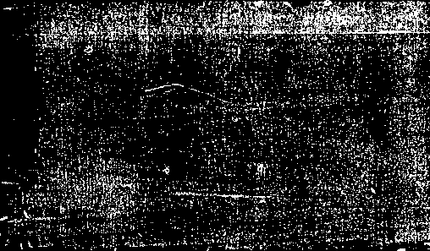
Customer: Do you mind if I try on that dress in the window?
Sales Assistant: Wouldn't it be better to use the fitting room?
“I went to a general store. They wouldn’t let me buy anything specifically".

Slide 11
Play
The final theory of humor that we will touch on here is the play theory. This claims that laughter is a kind of play sign in conversation, a demonstration that was thought to be serious is not.
The theory can be seen as combining many elements of other theories.
If someone is trying to be taken seriously and we laugh at them, we are being superior by making them appear less serious.
If everyone is worried about something dangerous, but it turns out to be innocent, we laugh to relieve the tension and signal to the group it is okay.
Things that don’t fit the pattern are funny because it reminds us that we are listening to something meant to be comic, not serious.

Slide 12
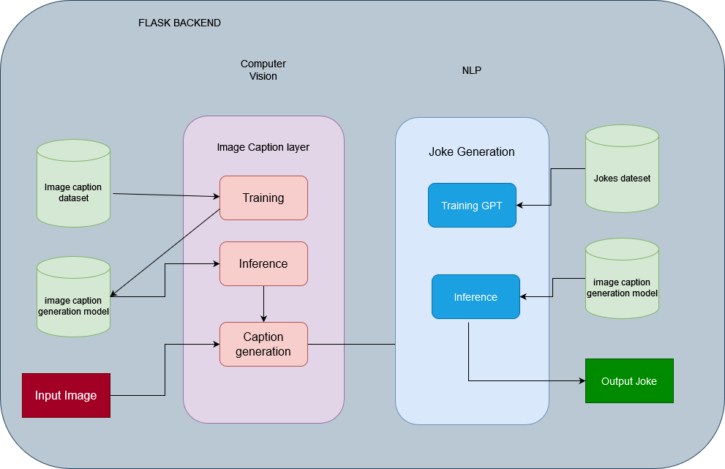
Architecture for the project

Slide 13
Image captioning
Process of generating a textual description of an image using NLP and CV.
CNN layer acts as an encoder and features of the image are extracted.
We have used
RNN (Recurrent Neural Network) acts as a decoder which does language modelling up to the word level.'
In Training, the output from the last hidden state of the CNN (Encoder) is given to the first step of the decoder.
In testing, the image representation is provided to the first time step of the decoder.

Slide 14
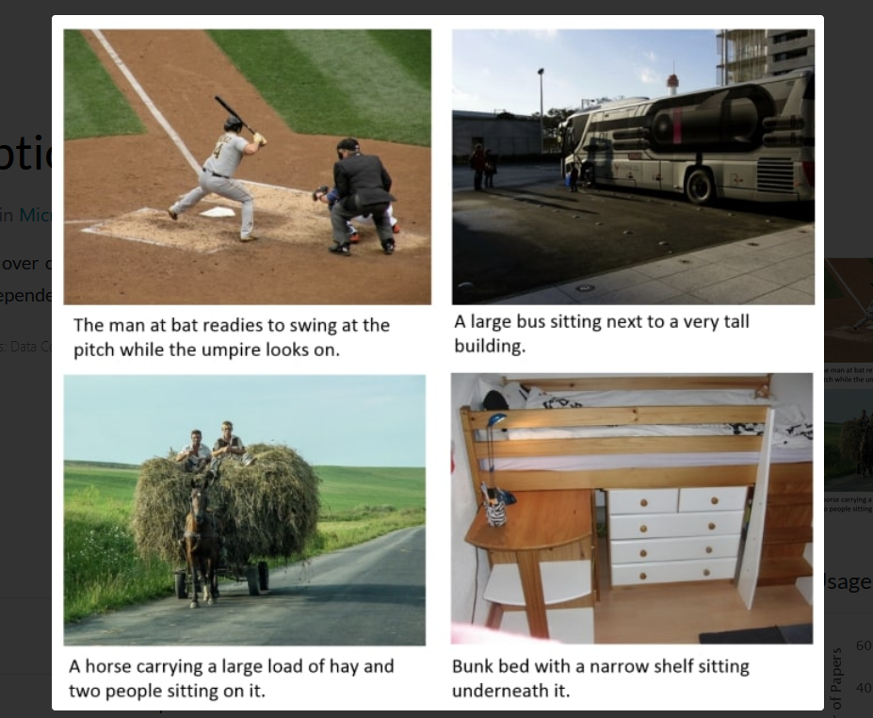
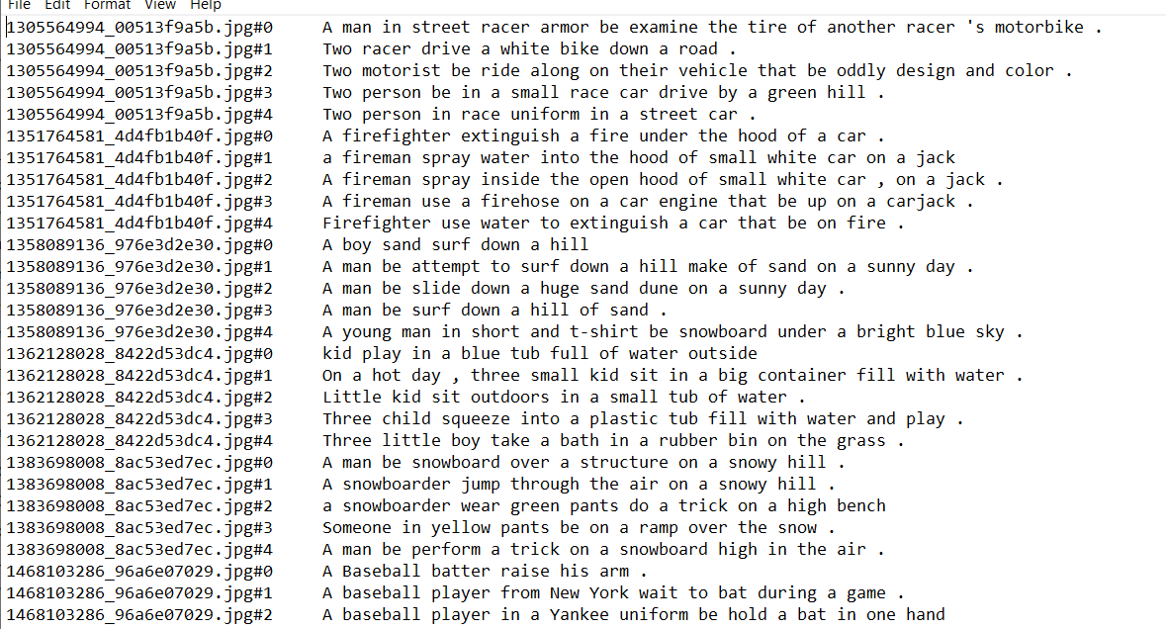
COCO DATASET

Slide 15
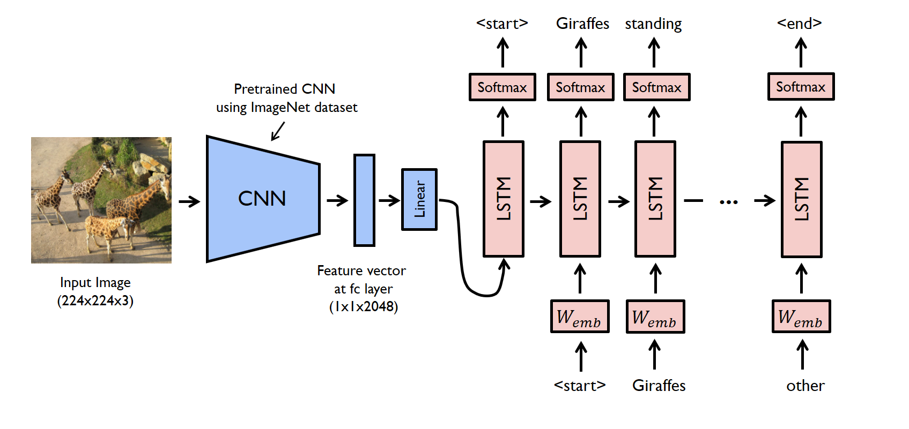
Image Captioning

Slide 16
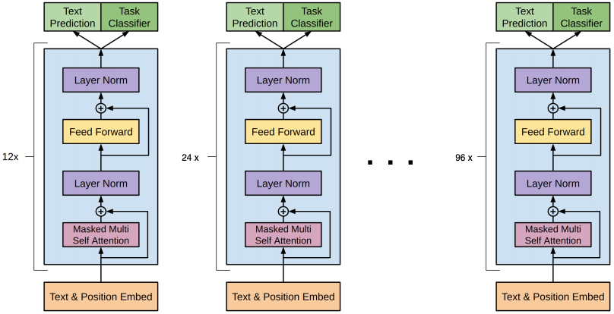
Joke Generation Model - GPt2
GPT 2 – Language Generation Model
Finetuned to Jokes dataset
Explainable AI

Slide 17
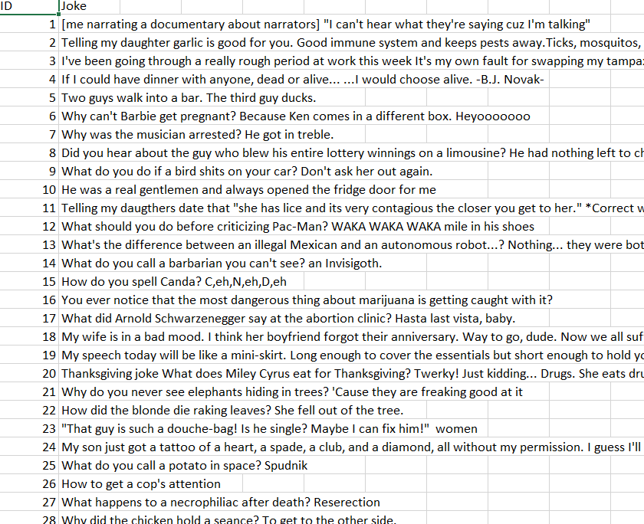
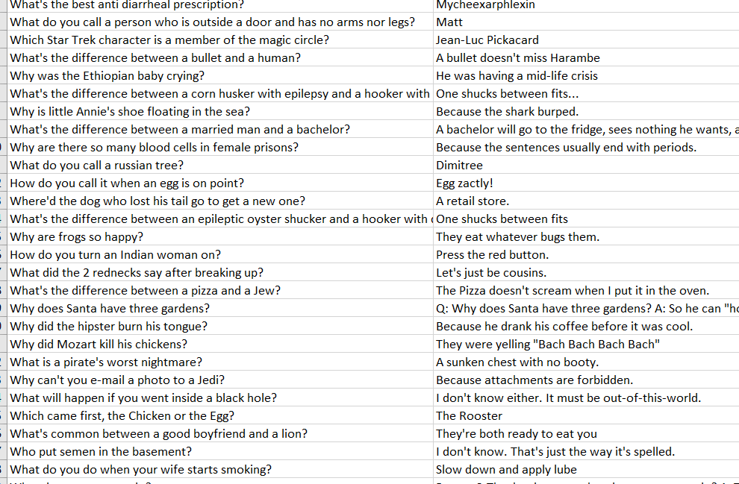
Dataset

Slide 18
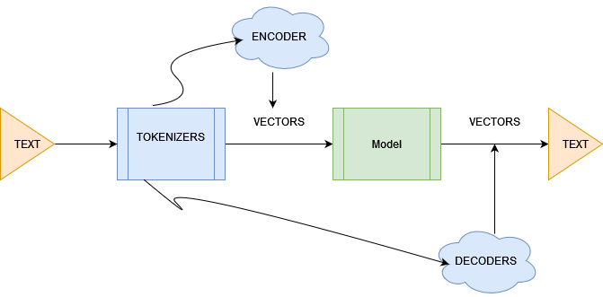
PROCESS WORKFLOW

Slide 19

RESULTS

Slide 20
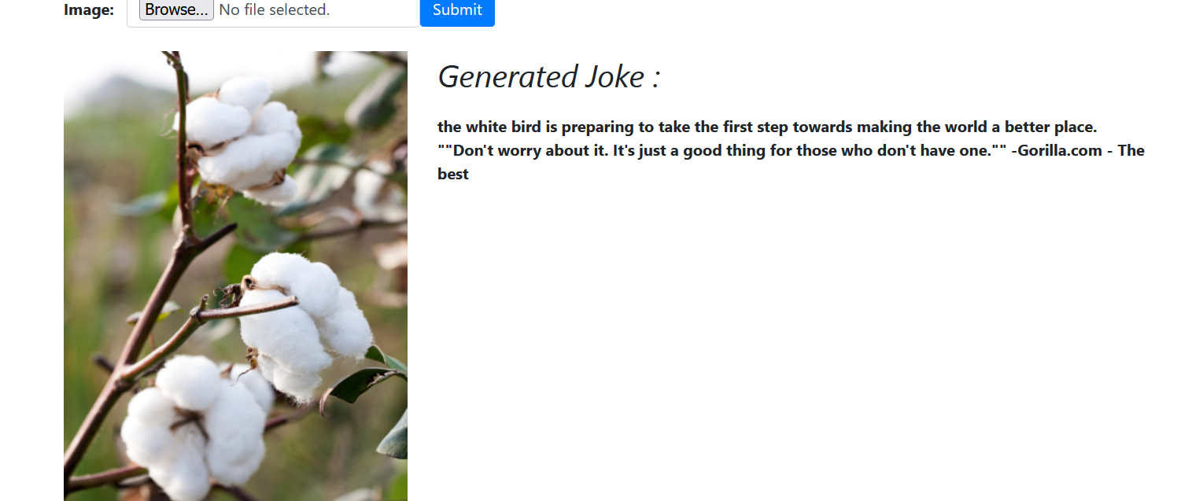

Slide 21
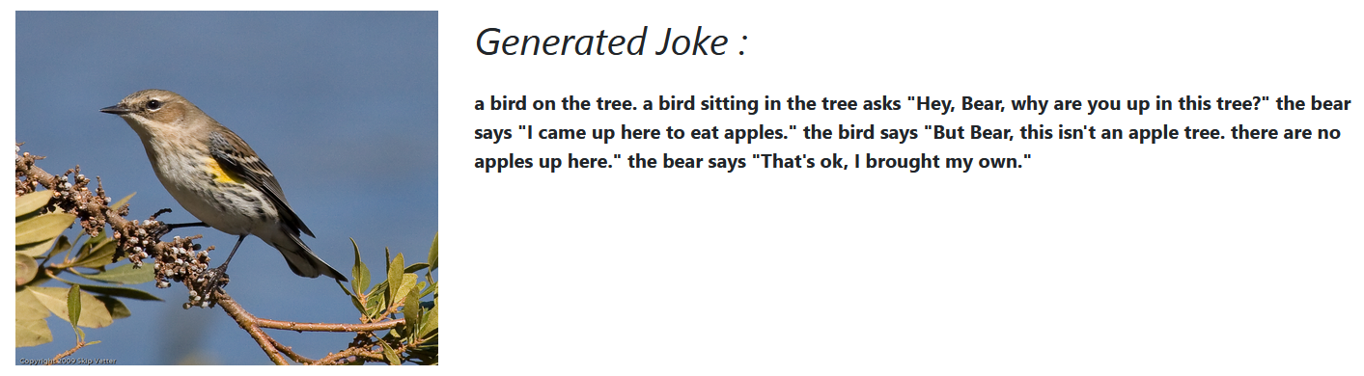

Slide 22
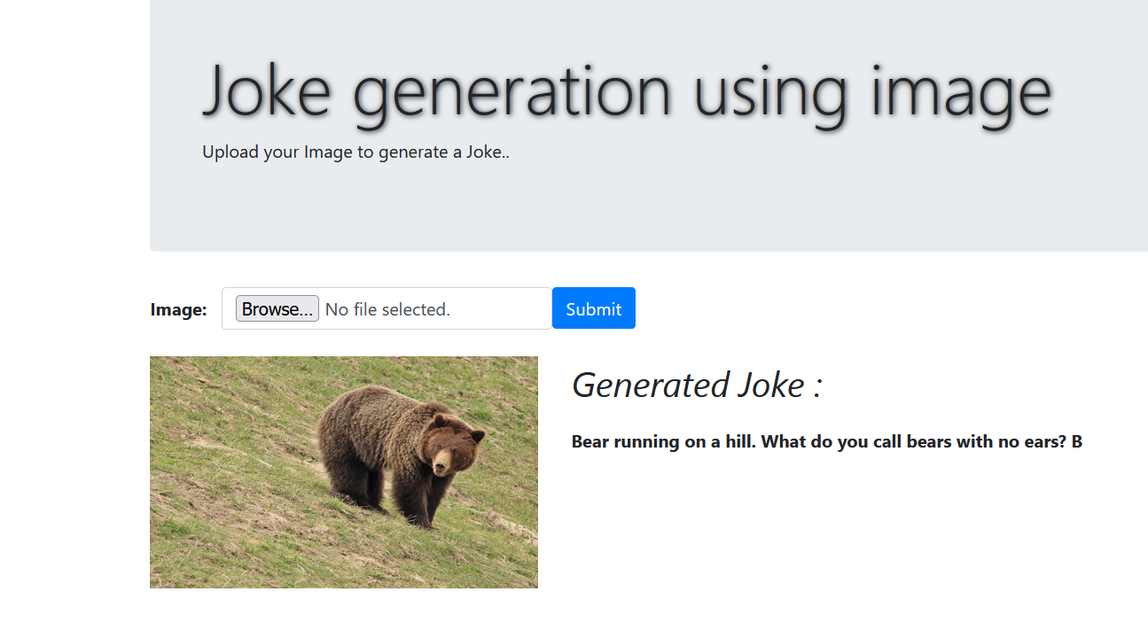

Slide 23
FUTURE WORKS
Finetuning the model with more varieties of dataset
Containerization
Serving models on the web for inference.

Slide 24
REFERENCES
Berger, Arthur Asa. “Humor: An Introduction.” American Behavioral Scientist 30.1 (1987): 6-15
Douglas, Mary. “Jokes.” Rethinking Popular Culture: Contemporary Perspectives in Cultural Studies. Eds. Chandra Mukerji and Michael Schudson. Berkeley: University of California Press, 1991. 291-310.
MIN, M., AND BURGHARDT, M. A survey on approaches to computational humor generation. ACL Anthology (2020).

Slide 25


Thank you

